Slide 1
Global Software Segment MI
Corporate Research Desk
Confidential
October, 2014
TCS Confidential

Slide 2
Global Software Services MI: Table of Content
Market Size & Forecast
Value Chain
Competitive Landscape
Deals Space
Business Trends
Technology Trends
Market Drivers
- 2 -
Notes:
2
12/23/09
2

Slide 3
Global Software Services MI
Market Size & Forecast

Slide 4
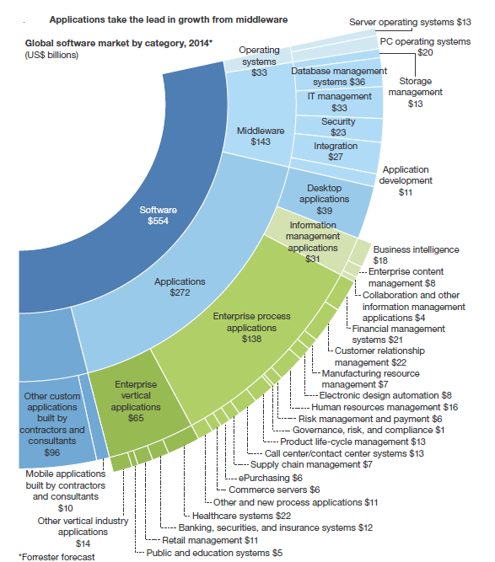
Global Market Size:
As per Forrester
Software Market is the biggest(25%) sector among all IT Products & Services market, globally. Applications Software is the key segment followed by Middleware software segment.
Notes:
Forrester

Slide 5
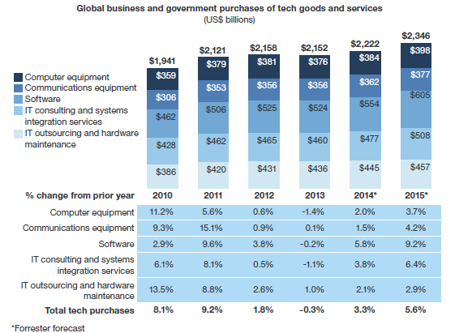
Global Market Size: Forecast
As per Forrester
Software market will reach as $554Billion in 2014 & $605Billion in 2015 with a healthy growth rate of 5.8% & 9.2% respectively.
Software’s fast growth reflects its important role in both customer-process tech and employee-process tech. It is also the technology with the most innovation in the form of cloud computing and adoption of software-as-a-service (SaaS) and platform-as-a-service (PaaS); smart computing and big data, real-time predictive analytics, and smart process apps; or mobile computing and mobile apps and enterprise app stores.
Notes:
Forrester

Slide 6
Global Market Size: Analysis
As per Forrester
The software market has four major segments: 1) operating systems ($33 billion in 2014); 2) middleware, like database management systems, app development tools, security software, and integration software ($143 billion); 3) applications, such as desktop applications, information management apps for analytics and content management, enterprise process apps, and vertical industry apps ($272 billion); and 4) custom software built for companies by contractors and consultants (with an estimated $10 billion for mobile apps and $96 billion for other custom apps).The largest single product category in our taxonomy is process applications, at $138 billion, followed by vertical industry applications ($65 billion) and desktop and collaboration apps ($39 billion). However, the fastest-growing segment will be information management applications like business intelligence, other analytical apps, content management, and business process management apps, with 9% growth projected for 2014
Market Size as per category
SaaS is of course the growth story in the application market, with SaaS applications growing by 28% in 2013, 24% in 2014, and 21% in 2015. But licensed software is not dead, though the slumping economies of 2013 caused license revenue growth to slow to just 2%. Better economic growth in 2014 will help license revenues grow by 6%, with the strongest license growth in business intelligence and vertical industry apps, where SaaS still has a limited presence. Information management apps and vertical industry apps will each rise by 9%.
SaaS has its biggest penetration in process apps like CRM, human resource management, and e Purchasing — thanks to these and other SaaS apps, enterprise process apps will rise by 10%.
The weakest applications category by revenue — not interest — will be desktop and collaboration apps, where growth will be just 5% in 2014 as business users take the lead in buying or renting lower cost apps like Google Docs, Box, Dropbox, and other products for sharing work documents with other employees.
Analytics and SaaS are drivers of software market growth
Notes:
Forrester

Slide 7
Global Market Size: Analysis
As per Forrester
Middleware and operating system software will lag
Spending on the middleware categories of storage management, database management, integration, IT management, security, and app development tools will rise by 7% in 2014 and by 5% in 2015. Cloud options in the near term are stealing revenues from on-premises licensed options, as well as reducing demand in categories like IT management, security, and app development due to usage of SaaS apps instead of on-premises software. Reflecting the slow recovery in computer equipment, operating system revenues will rise by 2% in 2014 and be flat in 2015.
Spending on SaaS continues to grow faster than the overall software market
While SaaS products can be found across the whole spectrum of software categories, they are concentrated in applications like CRM, human capital management, and ePurchasing; in desktop applications; and in middleware categories like security and application development. Growth will be around of 24% in 2014 and 21% in 2015
Mobile app development is driving growth in custom software development
The development of more complete and configurable on-premises software and the expansion of SaaS applications have reduced the need for custom development by contractors and consultants. However, mobile apps are giving new life to this category, which is growing rapidly
Notes:
Forrester

Slide 8
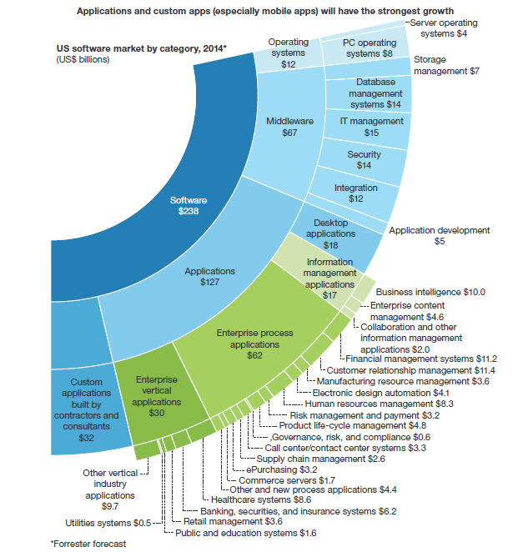
US Market Size:
As per Forrester
Software contributes 18.2% of total US tech market spending by US business & Government with market size of $238Billion; among that Applications & Middleware soft wares have largest market chunk ; Applications & Custom mobile apps have shown good growth rate.

Slide 9
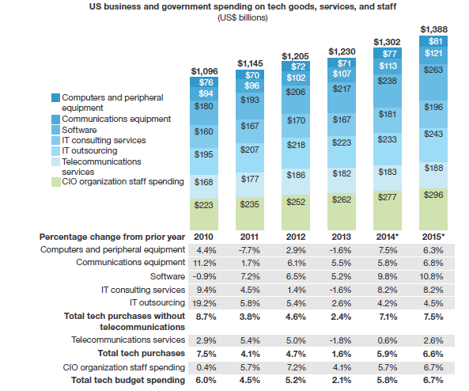
US Market Size: Forecast
As per Forrester
Software market will reach as $238Billion in 2014 & $263Billion in 2015 with a healthy growth rate of 9.8% & 10.8% respectively.

Slide 10
US Market Size: Analysis
As per Forrester
Software purchases will grow by 10%, with customer-facing software up 17%
Customer facing software will be about $44 billion (19% of the total US software market) in 2014, but spending will increase by 17% in both 2014 and 2015, continuing a string of double-digit increases as firms increase their focus on revenue growth from attracting and retaining customers. Employee-facing software will continue to be the largest part of US software spending, with its $121 billion in 2014 equaling 51%, and will grow at a 10% pace in 2014 and 11% in 2015. Infrastructure software, which is a bit less than a third, will increase by 6% in 2014
and 2015.
The creation of custom applications to run on mobile devices used by customers and employees is the hottest area in software. These apps are mostly being built for firms by outside resources like contractors and consultants (including those in advertising firms). While Forrester have not yet formally sized this market, first-pass estimates are that this software category will grow by more than 50% in 2014, reaching $7 billion. Commercial applications overall will also have strong growth of 8% in 2014 and 11% in 2015. Operating system software will generally track the performance of the respective hardware markets. Middleware will grow by 7% in both years, with integration software growing faster as firms look for tools to integrate their cloud apps with each other and with their internal systems and data, security software rising to meet greater exposures, and IT management software rising to support internal and external systems virtualization.
Mobile apps and commercial applications have strongest growth in 2014 and 2015

Slide 11
US Market Size: Analysis
As per Forrester
While analytical apps continue to be a hot area, the start of a transition to software-as-a-service (SaaS) will cause revenue growth to slow in 2014. The strongest growth will instead occur in customer-facing applications like customer relationship management (CRM) (including marketing automation) and commerce servers; among employee-facing apps for financial management, human resource management (HRM), governance, risk, and compliance (GRC), and supply chain management (SCM); and in the smart process apps that are included in “other” process. SaaS is a factor in many of these fast-growing applications, especially in CRM, HRM, ePurchasing, and smart process apps
Within applications, CRM, GRC, commerce servers, SCM, and new apps drive growth
US tech decision-makers toward the end of 2013 in Forrsights Budgets And Priorities Survey, more than half of respondents indicated that they would increase their spending in these three software areas by at least 5%.4 Our forecasts tend to align with these plans, though Forrester think actual spending growth on security and business intelligence will be a bit less robust than these plans would suggest. Only 38% to 41% of firms indicated that they would increase their spending by 5% or more on various SaaS applications, but this understates actual growth for two reasons: 1) Firms that already have SaaS products will tend to have small expected increases under their existing SaaS contracts, so those with bigger increases tend to be new clients; and 2) a small but growing proportion of SaaS purchases are being made directly by business users, out of the sight of the tech decision-makers we survey
Stated software spending plans focus on mobile, analytics, and security

Slide 12
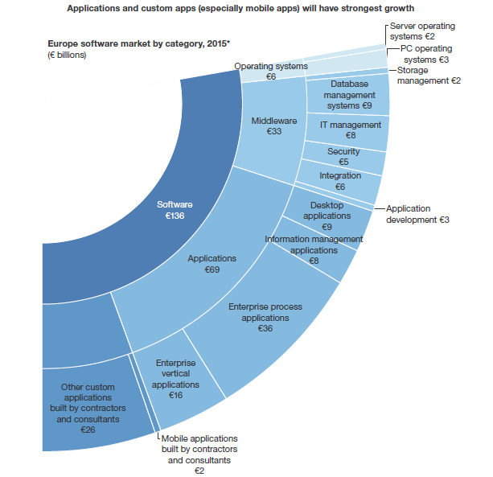
Europe Market Size: Forecast
As per Forrester
Software contributes 22.8% of total Europe tech purchase with market size of Euro 136 Billion; among that Applications & Middleware soft wares have largest market chunk ; Applications & Custom mobile apps have shown good growth rate.

Slide 13
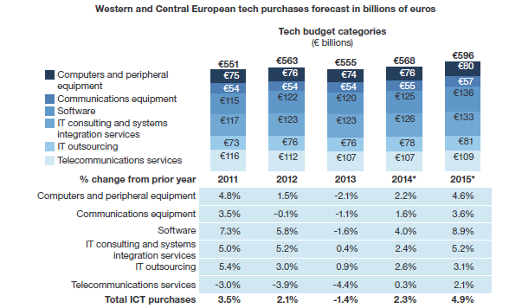
Europe Market Size: Forecast
As per Forrester
Europe Software market will reach to Euro125 Billion in 2014 & Euro 136 Billion in 2015 with a healthy growth rate of 4.0% & 8.9% respectively.

Slide 14
Europe Market Size: Analysis
As per Forrester
Mobile apps and applications have strongest growth in 2014 and 2015.
The creation of custom applications to run on mobile devices used by customers and by employees is the hottest area in software. These apps are mostly being built for firms by outside resources like contractors and consultants (including those in advertising firms). While we have not yet formally sized this market, our first-pass estimates are that this software category in Europe will grow by more than 94% in 2014 to more than €1 billion. Commercial applications overall will also have strong growth of 6% in 2014 and 8% in 2015. Operating system software will generally track the performance of the respective hardware markets. Middleware will grow by 5% in 2014 and 6% in 2015, with integration software growing faster as firms look for tools to integrate their cloud apps with each other and with their internal systems and data, security software rising to meet greater exposures, and IT management software rising to support internal and external systems virtualization
Within applications, CRM, GRC, contact centers, HRM, and new apps drive growth
The strongest growth will occur in collaboration and other information management applications with an increase of 30%. European CIOs are also increasing their spending on new enterprise process applications (such as smart process apps) and vertical industry applications. Customer facing applications like CRM and call center/contact center systems are also among the fast growing software categories
Customer process software like customer relationship management (CRM), marketing automation, commerce servers, web content management, contact center systems, mobile app development,
and customer-related analytics will be about €23 billion (19% of the total European software market) in 2014, but spending will increase by 11% in 2014 and 15% in 2015, as firms increase their focus on revenue growth from attracting and retaining customers. Employee-process software such as financial management systems, human resource management systems, ePurchasing software, supply chain management, product life-cycle management, governance, risk, and compliance, and operations-related analytics will continue to be the largest part of European software spending, with its €65 billion in 2014 equaling 52% of the total software, but growing by just 2% in 2014 before picking up the pace and growing by 9% in 2015. Infrastructure software like database management, storage management, application servers, and IT management software, which will be 29% of the European software market, will increase by 3% in 2014 and 4% in 2015
Software purchases will grow by 4%, with customer-process software up 11%

Slide 15
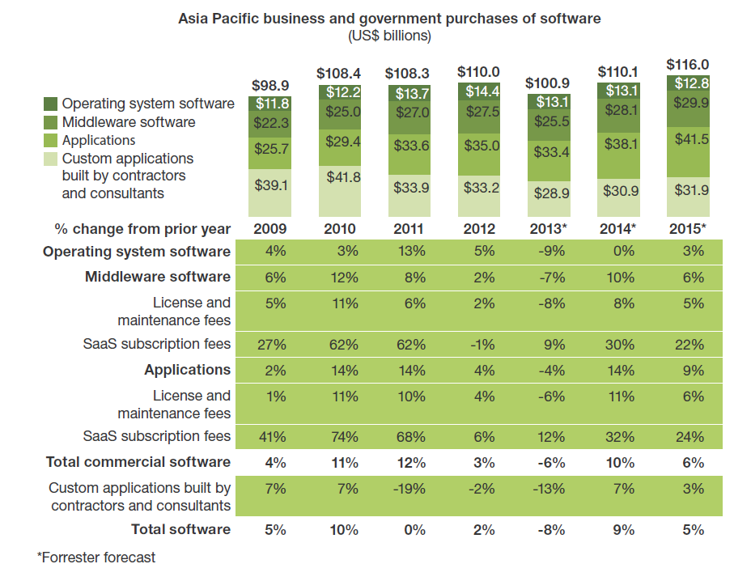
Asia pacific Market Size & Forecast
As per Forrester
Asia Pacific software market in US dollars will grow by 9% in 2014 & 5% in 2015 to reach $110.1Billion & $116.0Billion respectively, after an 8% drop in 2013; Applications & Custom mobile apps software have captured the large market share of software market.

Slide 16
Asia pacific Market Size & forecast: Software category
As per Forrester
Applications & Custom mobile apps software have captured the large market share of software market; Applications software will grow to $38.1Billion with growth rate of 14% whereas Custom applications software will grow to $30.9 Billion with a growth rate of 7%.

Slide 17
Global Software Services MI
Value Chain

Slide 18
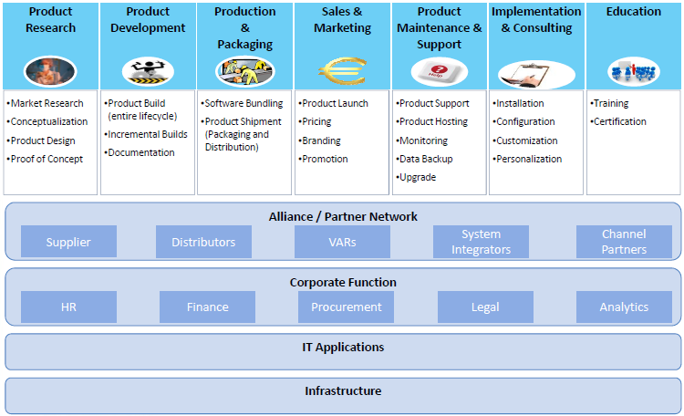
Global Software Services MI: Market Overview
Software Value Chain
Software Segment Value Chain

Slide 19
Global Software Services MI
Competitive Landscape

Slide 20
Competitive Landscape Porter’s 5 Forces Analysis
Rivalry
• Diversification tends to decrease rivalry, as it defends revenues from declines in any particular market segment.
• Continuous innovation on technology leads to new products being introduced to market, enhancing rivalry.
New Entrants
• Skilled employees & computer hardware are key inputs & low capital requirements mean entry is eased.
• New products are frequently launched.
• Significant R & D investment is required.
• Access to skilled software programmers by new entrants is challenged by existence of training paths offered by major players.
Buyer Power
• Buyers include individual consumers, businesses of all sizes & govt. institutions.
• Buyer often reliant on particular players for industry-specific software thus switching costs can be high.
• Strong bargaining power when buyers are large firms.
• Switching costs are lower in B2C software segment, when purchasing computer games. Although loyalty to games and consoles does not extend to software companies.
Threat of Substitutes
• Substitutes are open source software products, free web-based applications, and pirated versions of existing products.
• Distributors of open source software are small in comparison to traditional market players.
• Companies like Google are significant threat to conventional software market generating revenue from advertisements next to search results and on third-party sites.
• Google Apps Standard Edition is available free to end-user & offers functionality appropriate to non-business segment
Supplier Power
• Inputs like hardware components are often purchased from sole suppliers, often large companies offering differentiated products, resulting in significant supplier power.
• Forward integration from suppliers is rare as software production entails a highly complicated process.
- 20 -

Slide 21
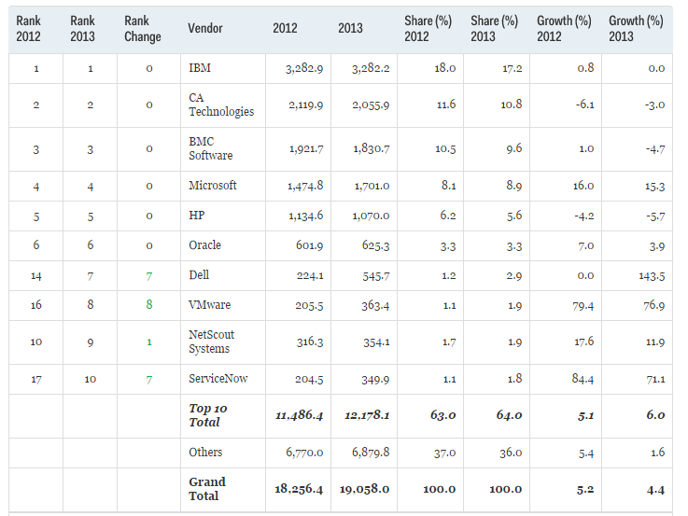
Competitive Landscape
Top IT Operations Management Software Vendors by Gartner
Notes:
Source: Gartner G00261132

Slide 22
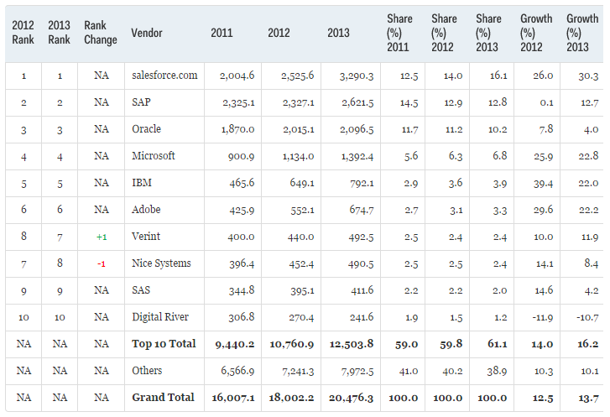
Competitive Landscape
Top CRM Software Vendors by Gartner
Salesforce.com continues to be the largest vendor overall in the CRM market and in the subsegment of sales automation. In the customer support and service market, salesforce.com has increased its rank to No. 2, passing Oracle, and has moved up three positions in marketing automation to No. 6 with its acquisition of ExactTarget.
SAP is still the leader in terms of revenue and market share ranking for the sub segments of customer service and e-commerce. The Hybris acquisition strengthened SAP's competitive position.
Adobe continues to lead the marketing automation market with its acquisition of Neolane and focus on multichannel campaign management and lead management, digital agencies, and SaaS.
Verint swapped spots with Nice Systems to become No. 7 at the top of the CRM market and to be fourth-ranked in customer support. Verint will further grow its base of revenue in 2014 with its acquisition of Kana.
Notes:
Source: G00262495

Slide 23
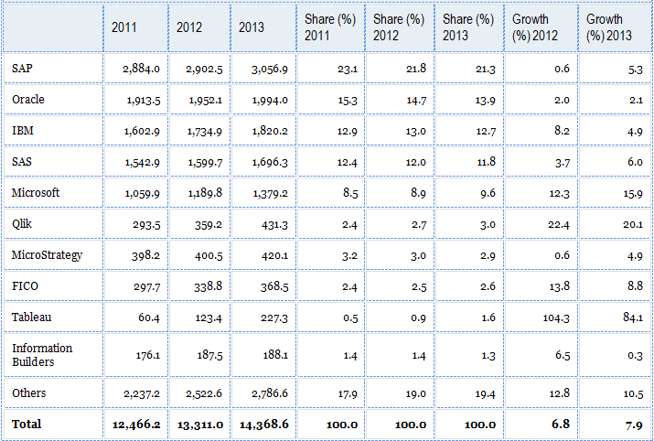
Competitive Landscape
Top BI & Analytics Software Vendors by Gartner
Notes:
Source: G00263514

Slide 24
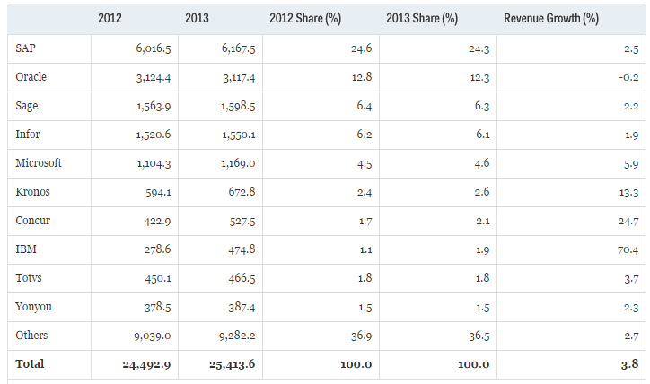
Competitive Landscape
Top ERP Software Vendors by Gartner

Slide 25
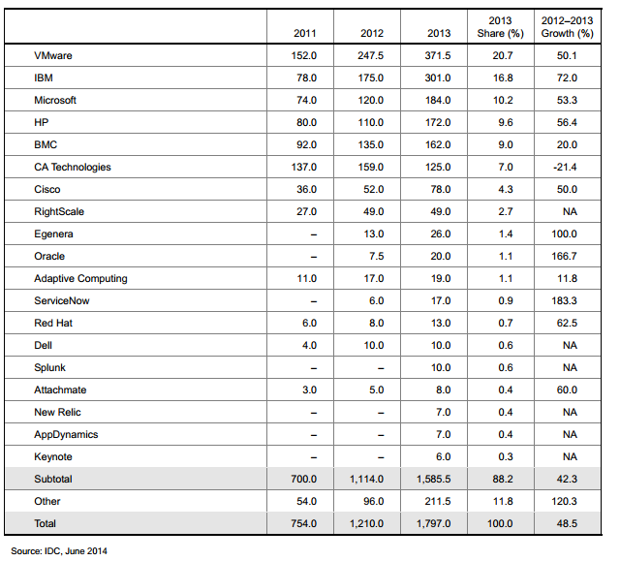
Competitive Landscape
Top Cloud Systems Management Software Vendors by IDC
*Values are in Million USD
Notes:
https://www.vmware.com/files/pdf/management/idc-cloudsystems-mgmt-vendor-shares-copy.pdf

Slide 26
Competitive Landscape Top Software Vendors(Geography wise)
Global TOP 10 Software Vendor by Revenue by PwC
North America TOP 20 Software Vendor by Revenue by PwC
Rank | Company | Software | Total | Software/Total | SaaS/Software | SaaS
1 | Microsoft | $57,668.40 | $72,052.00 | 80% | 1.40% | $788
2 | IBM | $28,187.75 | $106,916.00 | 26% | 0.90% | $265
3 | Oracle | $26,175.89 | $47,659.33 | 55% | 1.70% | $446
4 | SAP | $15,498.14 | $19,794.98 | 78% | 1.40% | $220
5 | Ericsson* | $8,034.67 | $34,933.33 | 23% | 0.00% | $-
6 | Symantec | $6,330.31 | $6,722.00 | 94% | 9.00% | $572
7 | HP | $5,316.26 | $125,734.33 | 4% | 4.30% | $228
8 | EMC (excluding Vmware) | $4,884.92 | $20,007.50 | 24% | 1.80% | $90
9 | CA Technologies | $4,375.31 | $4,754.00 | 92% | 1.50% | $-
10 | Adobe | $4,154.07 | $4,223.70 | 98% | 9.90% | $410
Rank | Company | Country | Software | Total | Software/Total
1 | Microsoft | US | $57,668.40 | $72,052.00 | 80%
2 | IBM | US | $28,187.75 | $106,916.00 | 26%
3 | Oracle | US | $26,175.89 | $47,659.33 | 55%
4 | Symantec | US | $6,330.31 | $6,722.00 | 94%
5 | HP | US | $5,316.26 | $125,734.33 | 4%
6 | EMC (excluding Vmware) | US | $4,884.92 | $20,007.50 | 24%
7 | CA Technologies | US | $4,375.31 | $4,754.00 | 92%
8 | Adobe | US | $4,154.07 | $4,223.70 | 98%
9 | VMware | US | $3,485.83 | $3,767.00 | 93%
10 | SAS | US | $2,524.87 | $2,725.00 | 93%
11 | Intuit | US | $2,456.47 | $4,007.00 | 61%
12 | Autodesk | US | $2,120.03 | $2,194.03 | 97%
13 | Salesforce.com | US | $2,008.69 | $2,208.25 | 91%
14 | BMC Software | US | $1,961.70 | $2,169.50 | 90%
15 | Infor | US | $1,889.60 | $2,131.36 | 89%
16 | Cisco | US | $1,796.85 | $44,471.00 | 4%
17 | Intel | US | $1,704.52 | $53,999.00 | 3%
18 | Citrix | US | $1,644.71 | $2,206.50 | 75%
19 | SunGard | US | $1,471.45 | $4,499.00 | 33%
20 | Synopsys | US | $1,459.72 | $1,576.14 | 93%
Notes:
Factiva

Slide 27
Competitive Landscape Top Software Vendors(Category wise)
Top 5 BI, CPM and Analytic Applications/Performance Management Vendors, Worldwide, 2011-2012 by Gartner
Top 10 Cloud Service Provider Companies
Top 10 SaaS Revenue from Global 100 by PwC
Rank | Company
1 | Amazon Web Services
2 | Rackspace
3 | Century Link/Savvis
4 | Salesforce.com
5 | Verizon/Terremark
6 | Joyent
7 | Citrix
8 | Bluelock
9 | Microsoft
10 | VMware
Company | 2011 SaaS Revenue ($M) | 2011 Software Revenue ($M) | SaaS Revenue as % of Software Revenue
Salesforce.com | $1,848 | $2,008.7 | 92.0%
Intuit | $950 | $2,456.5 | 38.7%
Cisco | $831 | $1,796.9 | 46.3%
Microsoft | $788 | $57,668.4 | 1.4%
Symantec | $572 | $6,330.3 | 9.0%
Google Inc. | $462 | $575.6 | 80.3%
Oracle | $446 | $26,175.9 | 1.7%
Adobe | $410 | $4,154.1 | 9.9%
Blackboard | $396 | $411.7 | 96.2%
DATEV | $395 | $974.2 | 40.5%
 | $7,098 | $102,552.16 | 6.9%
Company | 2012 Revenue(m$) | 2012 Market Share | 2011 Revenue(m$) | Growth Rate(%)
SAP | 2902.5 | 22.1 | 2884 | .6%
Oracle | 1952.1 | 14.9 | 1913.5 | 2%
IBM | 1625.6 | 12.4 | 1478.8 | 9.9%
SAS | 1599.7 | 12.2 | 1542.9 | 3.7%
Microsoft | 1189.3 | 9.1 | 1059.9 | 12.2%
Others | 3861.3 | 29.3 | 3416 | 13%
Total | 13131.1 | 100 | 12295.1 | 6.8%
2013 ERP Market Share Update by Forbes
Rank | Company | 2012 Revenue | 2012 Market Share
1 | SAP | $6B | 25%
2 | Oracle | $3.12B | 12.8%
3 | Sage | $1.5B | 6.3%
4 | Infor | $1.5B | 6% (49.5% Revenue Growth Y-o-Y)
5 | Microsoft | $1.1B | 5%(4.2% Revenue Growth Y-o-Y)

Slide 28
Competitive Landscape Top Commercial Software Vendors (as per IDC)*
 | 2010 | 2011 | 2012 | 2011–2012 Growth (%) | 2012 Share (%) | 2012 Rank
Microsoft | 54,112.90 | 57,694.20 | 58,453.60 | 1.3 | 17.06 | 1
IBM | 26,454.80 | 28,860.50 | 29,129.10 | 0.9 | 8.501 | 2
Oracle | 23,693.40 | 26,772.20 | 27,826.00 | 3.9 | 8.121 | 3
SAP | 13,763.90 | 16,160.50 | 16,988.50 | 5.1 | 4.958 | 4
Symantec | 5,747.20 | 6,417.20 | 6,423.00 | 0.1 | 1.875 | 5
HP | 6,002.10 | 6,131.40 | 5,512.50 | -10.1 | 1.609 | 6
EMC | 4,368.90 | 4,906.80 | 5,139.80 | 4.7 | 1.5 | 7
Adobe | 3,785.30 | 4,200.40 | 4,337.00 | 3.3 | 1.266 | 8
CA Technologies | 4,081.20 | 4,386.40 | 4,304.40 | -1.9 | 1.256 | 9
VMware | 2,670.40 | 3,518.20 | 4,252.70 | 20.9 | 1.241 | 10
Fujitsu | 2,787.20 | 3,060.30 | 3,131.00 | 2.3 | 0.914 | 11
Salesforce.com | 1,546.90 | 2,106.70 | 2,825.30 | 34.1 | 0.825 | 12
SAS | 2,257.10 | 2,529.80 | 2,665.80 | 5.4 | 0.778 | 13
Intuit | 2,186.10 | 2,456.50 | 2,464.80 | 0.3 | 0.719 | 14
Infor | 2,119.40 | 2,294.10 | 2,464.40 | 7.4 | 0.719 | 15
Siemens | 2,225.70 | 2,396.00 | 2,454.50 | 2.4 | 0.716 | 16
Dassault Systèmes | 1,904.40 | 2,235.60 | 2,268.90 | 1.5 | 0.662 | 17
Autodesk | 1,849.80 | 2,120.00 | 2,263.00 | 6.7 | 0.66 | 18
Citrix | 1,640.60 | 1,850.90 | 2,099.30 | 13.4 | 0.613 | 19
Cisco | 1,752.70 | 1,800.90 | 1,999.80 | 11 | 0.584 | 20
BMC | 1,925.60 | 2,054.60 | 1,982.50 | -3.5 | 0.579 | 21
Hitachi | 1,761.60 | 1,939.00 | 1,980.00 | 2.1 | 0.578 | 22
NEC | 1,450.80 | 1,616.60 | 1,942.20 | 20.1 | 0.567 | 23
Sage | 1,807.90 | 1,919.60 | 1,789.90 | -6.8 | 0.522 | 24
Synopsys | 1,514.80 | 1,675.10 | 1,721.20 | 2.8 | 0.502 | 25
* As per latest published financial data(2013 data is yet not published)

Slide 29
Deals Space Contract Details
All Contracts
Existing Contracts
Contracts Expiring in 2015 & 2016
Notes:
IDC

Slide 30
Global Software Services MI
Business Trends

Slide 31
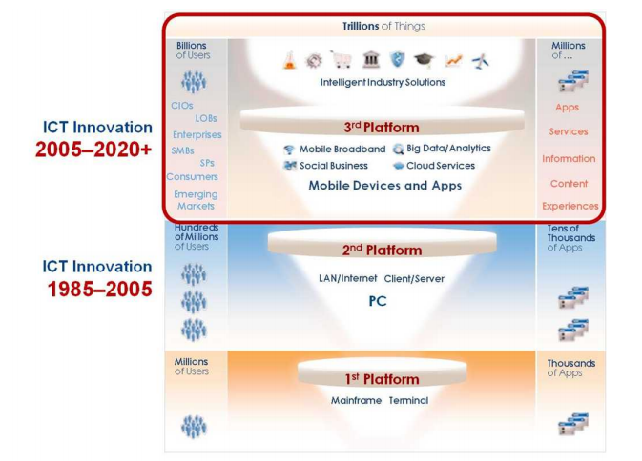
Business Trends: Third platform will drive the Growth
By 2020, 40% of the industry's revenue and — incredibly — 98% of its growth will be driven by 3rd Platform technologies that represent just 22% of ICT spending.
The most important trends and events in 2013 was cluster around mobility, cloud services, social technologies, and Big Data, as well as the emerging high-value industry solutions built on top of them, and the rising vendors (e.g., service providers [SPs] and "industry platform as a service [PaaS]" providers [SPs] and "industry platform as a service [PaaS]" business executives, and emerging market customers) that will play leading roles in much of the next eight years' growth.
3rd Platform markets and technologies will drive big share shifts, such as smartphones, SaaS (versus packaged software), and cloud servers (versus physical servers).
Notes:
http://www.idc.com/research/Predictions13/downloadable/238044.pdf

Slide 32
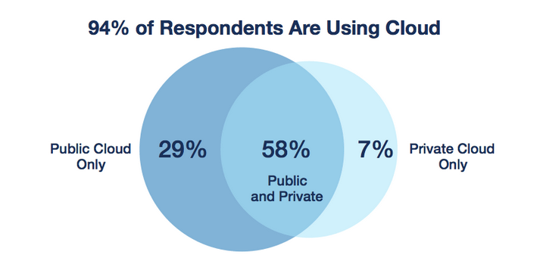
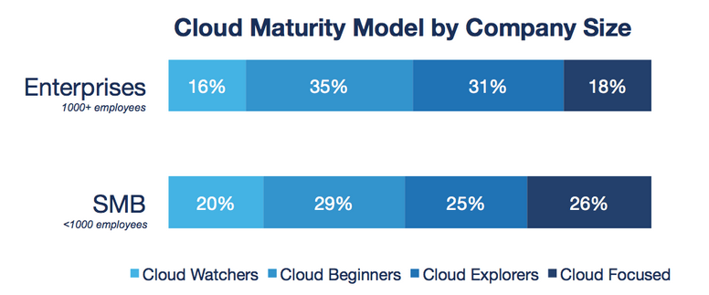
Business Trends: Cloud Computing Trends
94 percent of organizations surveyed are running applications or experimenting with infrastructure-as-a-service and 87 percent of organizations are using public cloud.
Cloud adoption is significant, it is interesting to note that enterprise respondents are more heavily clustered in the middle stages of Cloud Beginners and Cloud Explorers. Enterprises are enthusiastically moving forward in their journey to cloud. While their transformation may take longer than that of smaller organizations, it is clear that very few enterprises will remain on the sidelines.

Slide 33
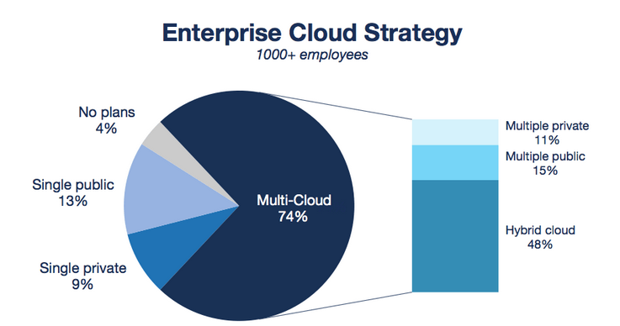
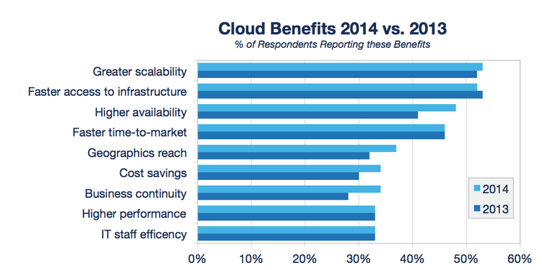
Business Trends: Cloud Computing Trends
Hybrid and multi-cloud implementations continue to be the end goal for the enterprise: 74 percent of enterprise respondents have a multi-cloud strategy, and 48 percent are planning for hybrid clouds.
Cloud maturity matters. As organizations adopt cloud more broadly, they realize increasingly more value, and the challenges of adopting cloud decline. Organizations indicate that the top benefits that they have already realized are greater scalability, faster access to infrastructure, higher availability, and faster time to market for applications.

Slide 34
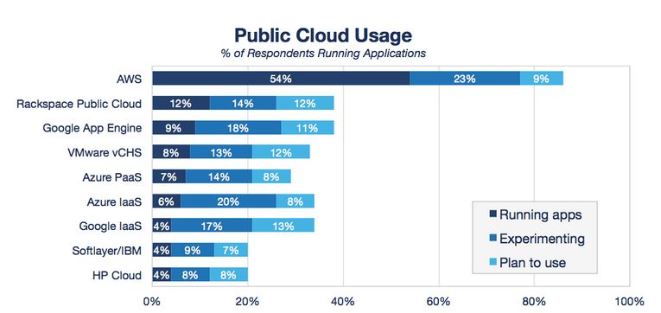
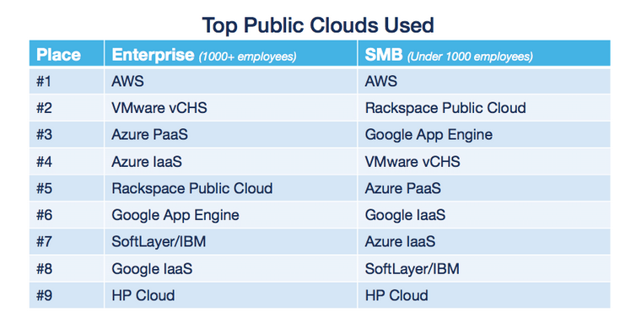
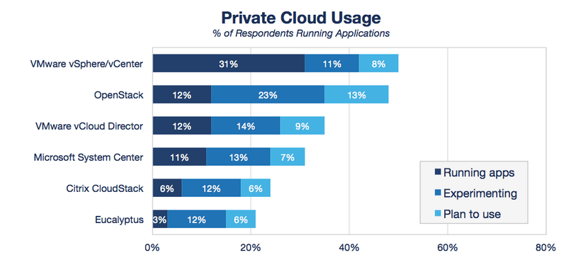
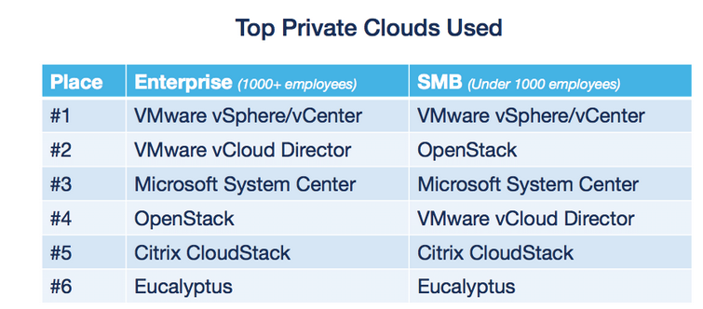
Business Trends: Cloud Computing Trends
AWS continues to lead in public cloud adoption, with 54 percent of respondents currently running applications in this cloud. This is more than 4x the adoption rate of the second most used cloud, Rackspace Public Cloud. Google App Engine rounded out the top 3 in current adoption.
The battle among private cloud technologies is shaping up as a clash of cultures between the open-source OpenStack and proprietary solutions from VMware.
Notes:
http://www.rightscale.com/blog/cloud-industry-insights/cloud-computing-trends-2014-state-cloud-survey

Slide 35
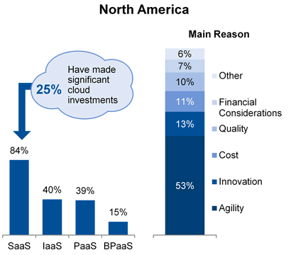
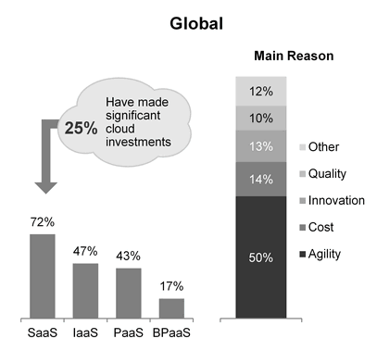
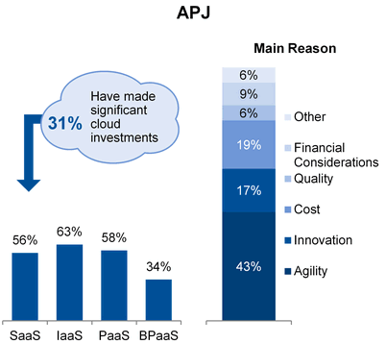
Business Trends: Cloud Computing Trends
In the use of the cloud, North American CIOs have a slightly larger focus on agility than their global counterparts — and a slightly larger use of SaaS, as opposed to infrastructure as a service (IaaS) or platform as a service (PaaS). However, as only 26% of North American CIOs report they have made significant use of public cloud offerings, the majority of North American CIOs still need to venture into significant public cloud usage. Correlating the facts that the CIOs who are using public cloud are driven by agility, that cloud is priority No. 5, and that business focus is shifting toward growth and innovation, the recommendation is that North American CIOs not already employing public cloud offerings should look to their peers, and should consider if applying cloud offerings can help supporting their overall business objectives.
North America
The survey drilled down on this important trend to show that nearly one-third of APJ businesses are enthusiastic adopters of public cloud, indicating significant investments, which places them ahead of their global peers. The main driver of this shift to public cloud was the need for greater agility, which is more strongly indicated for APJ than the global average. The other striking difference between APJ IT leaders and their global peers is the type of cloud services being purchased. In APJ, only 56% of respondents are using SaaS, whereas this figure is much higher globally (72%). This implies that the majority of cloud services are being consumed by the IT function rather than business units directly. An explanation for this lies in the relatively easer path to public cloud for the APJ enterprise. It is likely that, with fewer issues of "legacy" to deal with, avoiding the complexity of hybrid cloud approaches for APJ public cloud is an easier route. It is also likely that — for some, at least — the pressure to "move" to supporting growth, even as they're still establishing the foundational "run" elements, often leaves APJ IT leaders with no choice but to look at the cloud for these foundational elements, with all the attendant risks.
Asia Pacific & Japan
Notes:
Gartner

Slide 36
Business Trends: BI & Analytics
Big data confusion will inhibit spending on BI and analytics software to single-digit growth
While BI and analytics continue to be a top priority for the third year running, the reality is that most organizations are already invested — perhaps even overinvested — in IT-driven BI and analytic tools. Even though big data hype reached a fever pitch, this did little to move the dial for analytics. It's noteworthy that both DBMS and data integration were faster-growing segments compared with BI and analytics in 2013, insinuating that much of the big data focus is still on the data management layer underneath analytics. Only 8% of Gartner surveyed organizations have reached deployment with big data, with another 57% in the knowledge gathering, strategy developing and piloting stages. Hence, investments in big data are still largely experimental, prolonging upgrade cycles in more enterprise wide initiatives. These results were all in line with Gartner's prediction that, "Until 2016, big data confusion will inhibit spending on BI and analytics software to single-digit growth"
Data discovery tools saw a disproportionate amount of demand and growth in 2013
This segment, while accounting for only about 13% of the BI platform market, represented upward of three times that proportion in net-new buying. In short, data discovery can be described as agile, self-service tools with intuitive interfaces geared for analysis in particular, with a built-in performance layer and proprietary data structure to store and model data from different data sources. Overall, these dynamics have moved the whole market into a more competitive phase, where independent data discovery and incumbent BI vendors have started to clash, prolonging sales cycles. This has affected vendors differently: Tableau continued its land grab nearly unfazed, growing 84%. Qlik came out pretty well, with 20% growth, while Tibco Spotfire's sales were hurt, growing only in the single digits.

Slide 37
Business Trends: BI & Analytics
Cloud BI Starting to Show Signs of Life
In annualized revenue — where "the rubber meets the road" — BI and analytics in the cloud represented only 4% of the total in 2013. On the demand side, the BI and analytics Magic Quadrant showed that deployment intentions jumped significantly, from 33% of surveyed organizations to 45%. Small businesses in particular have shifted their mentality around cloud and see it as an enabler to do more advanced things with big data and analytics, just like "the big boys." As more and more data is gradually moving or being created in the cloud, so will the analysis — a concept referred to as "data gravity." The venture capital firms bet big on this in 2013 and the beginning of 2014, with, among others, Birst, GoodData, Looker and Domo receiving significant injections. On the CPM side, Adaptive Insights and Host Analytics showed significant gains.
Expect more also from traditional BI vendors. For example, MicroStrategy drove cloud successfully in 2013. Jaspersoft introduced utility-priced BI on Amazon Elastic MapReduce in late 2013, and Tableau introduced its cloud BI product, Tableau Online. In 2014, Microsoft and Oracle will have major releases, adding further validation to the space. But so far, out of these and many more cloud vendors, no one clear leader has been able to distance itself from the pack.
Advanced Analytics the Fastest-Growing Segment
Many vendors and tools in this Advanced Analytics segment — collectively sized at $1 billion — have been around for decades (longer than the "business intelligence" segment). And yet, because of renewed interest in predictive and prescriptive styles, it's the fastest-growing segment, at 12%. The two dominant vendors, SAS and IBM, held two-thirds of the share in 2013, with a long tail of specialist vendors filling out the rest. A third "megavendor," SAP, made moves to join that group in 2013, acquiring KXEN. On the supply side, there were significant efforts to make advanced analysis more accessible to broader constituents of users (for example, combining it with data discovery styles of BI, or experimenting with cloud-based hybrid software and service models) and through this expand the addressable market. This dynamic caused significant product changes and new feature releases.

Slide 38
Business Trends: CRM
CRM will be at the heart of digital initiatives in coming years. Hot areas for CRM investment include mobility, social media and technologies, Web analytics, and e-commerce. The rapidly growing use of social technologies from mobile devices means enterprises need to address both trends from the perspectives of strategy, technology, process and governance.
Trend: CRM Impact on Industries
The communications, media and IT services vertical industries are the largest spenders on CRM because they focus on large groups using call center technologies. They also invest more to improve analytics-related areas and improve/provide more consistent customer experiences.
Manufacturing (including consumer packaged goods) is in second place, with these companies using CRM for product and channel management.
Third-ranked is banking and securities, in which customer service and upselling to other financial products are core to growth. These industries also require a greater use of call centers in computerized CRM.
All these industries are required to build out infrastructure in emerging countries and are the focus of spending in many mature countries as modernization for infrastructure and applications becomes the norm. Spending on different CRM technologies is not even: Across 38 areas, sales force automation, contact center customer service, e-commerce and campaign management applications receive about 75% of all spending . Many other areas get less than 1% of spending).
Implications on CRM vendors
Vendors continue to fill out their product portfolios in all areas of CRM through acquisition and new product launches. Vendors continued to expand their offerings with new features and functionality, often through acquisition. The wave of consolidation activity that began flowing through the market in 2009 continued throughout 2013 (with more than 25 acquisitions). This resulted in increased competition at the top end of the CRM market, with the continued focus of global vendors' sales forces driving good growth across the globe in customer support and sales, and slower-than-anticipated marketing growth. The acquisitions slowed down growth.
In 2013, the marketing segment was transformed by multiple mergers and acquisitions that enabled large enterprise application and CRM vendors to provide best-of-breed lead management functionality. They also enabled vendors to build out their vision of an integrated set of marketing automation applications and look to consolidate multiple point capabilities into an integrated marketing automation offering.
Notes:
Gartner

Slide 39
Business Trends: ERP
Company & User Adoption: Through 2018, it will take an average of 10 to 30 years for a region to reach complete adoption of ERP & implement it.
ERP implementations tend to be very complex in nature, with small and simple implementations taking three to six months and large complex implementations taking multiple years. Some of the effort is down to coding and customization efforts for functional completeness, but a lot of time is related to the adopting company being able to absorb, test, refine, and stabilize the implementation. The majority of large and midsize organizations in mature markets have already adopted ERP, with small or midsize businesses comprising the remaining organizations that will still adopt this software over the next 10 to 15 years in those regions (Macro Regional level).
The total time taken for ERP licenses to fully penetrate the organization can take up to 10 years depending on industry, size of company and geography. Much of the variability is related to the complexity of project — that is, whether it is a multiphase project or a big bang project — as well as changes to the profile and makeup of the company over time if it is involved in merger and acquisition activity (Organizational level).
Functionalities Expansion: Through 2018, businesses will spend up to 40% of the initial license cost to add new ERP functionality in the 10 to 15 years following implementation
Unlike first-generation ERP systems, systems today behave more like a platform, allowing faster and "easier" incremental expansion of functionality over time through the purchase of new modules. Modularity is essential in today's world to allow customers to build and evolve their ERP in a more flexible way and to allow the system to be more agile to suit the requirements of a modern business. The additional spend for new functionality varies between 20% for license-based software to 40% for open-source software.
Pricing Trend: For the foreseeable future, on-premises license pricing will not see any sharp increases or decreases.
Gartner have assumed that the price point for ERP licenses will remain relatively stable through 2018 and beyond. While there will of course be small annual increases to list prices, the effect will be largely offset by the combined effect of first-year or new customer discounts. For scenario through 2018 and beyond, Gartner have thus assumed a consistency of pricing levels. However, if there is a sudden macroshock like the recession in 2008, then this would have a downward overall effect on pricing.

Slide 40
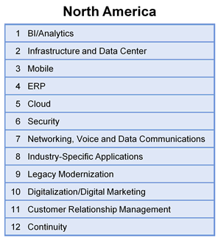
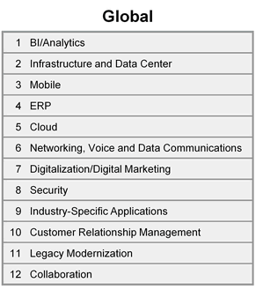
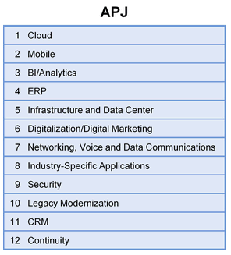
Business Trends: Gartner Predicted Technology Focus
North America
North America continues to lead the investment into digitalization. Yet, the region is also more heavily burdened by legacy systems and organization models, creating a drag on the pace of change. As emerging markets shift more resources toward innovation, North American companies may have to consider more-radical strategies to break with the past.
The survey results clearly show that new major categories of spending are split between two important imperatives. The first is mobile itself, which is unsurprising, given the rapid growth in market adoption of mobile-data-enabled smartphones and tablets, the increased popularity of BYOD, and the explosion in the number of devices capable of participating in the Internet of Things. In general, this mobile investment breaks into app development and device management. This is followed by business analytics, as APJ enterprises seek to better understand and manage the drivers of business performance.
The second area of significant investment for APJ IT leaders is renovating the core of IT — in other words, ensuring that the infrastructure, as well as the main IT applications and services, such as data center, ERP and networks, are fit for purpose to ensure that the core is digital-ready.
Asia Pacific & Japan
Notes:
Gartner

Slide 41
Business Trends: Software Pricing Trends
Major focus on service and support as key differentiators. A detailed review of the product functionality of the service which is delivering will help customers optimize a business process.
Vendors will focus more on selling products through cloud based subscription model. For recurring predictable revenue, vendors are shifting from traditional perpetual license model to cloud-based subscription model. Consumers will also be benefited by having the software more affordable than the high upfront cost of a perpetual fee structure
Adoption of software-as-a-service models. Software-as-a-service offering has lower infrastructure and support cost than on-premise licensed software
Shift from perpetual to subscription and usage-based licensing and pricing models. With the emergence of commercial open source (COS) and software-as-a-service models, several organizations are experimenting with service offerings that use periodic payments, software rental, subscriptions and COS in addition to up-front, perpetual licenses
Transition from the traditional per device software licensing model to per user software licensing model. Traditional model involves annual renewable license models that contains maintenance elements linked to the number of users. But now with the transition to cloud computing, traditional software licensing paradigms are giving way to pay-per usage mode
Licensing policies are changing to address the cloud, SaaS, virtualization, mobile and software appliances
Aggressive practice of auditing the customers by vendors.
Notes:
http://www.stylusinc.com/new/bloghome/stylusposts-pricing-trends/

Slide 42
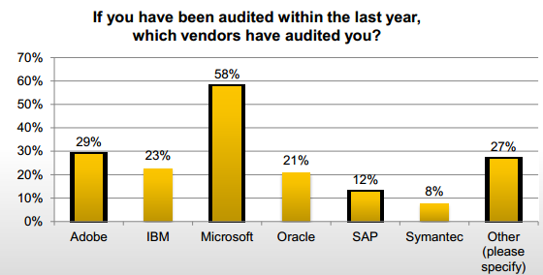
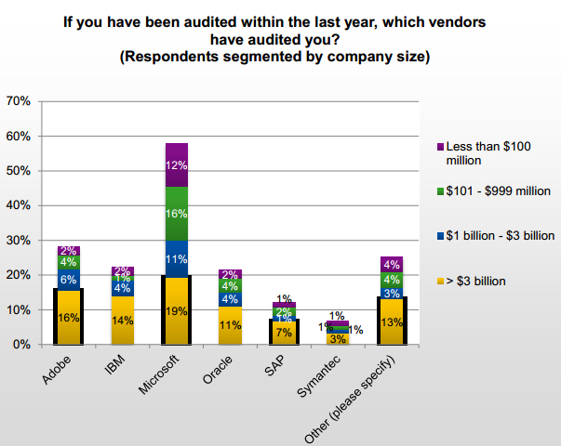
Business Trends: Software Pricing Trends
Software Firms are aggressively auditing their Customers
All major vendors are auditing but Microsoft is the most aggressive and it’s going after organizations of all sizes; In the 2012 study, 51% of respondents said they had been audited by Microsoft during the prior year, 27% by Oracle, 24% by IBM, 22% by SAP and 19% by Adobe.
Notes:
http://www.doctor-license.com/blog/wp-content/uploads/2014/05/Survey-SLO-Key-Trends-Audits-Cost-Risk2.pdf

Slide 43
Global Software Services MI
Technology Trends

Slide 44
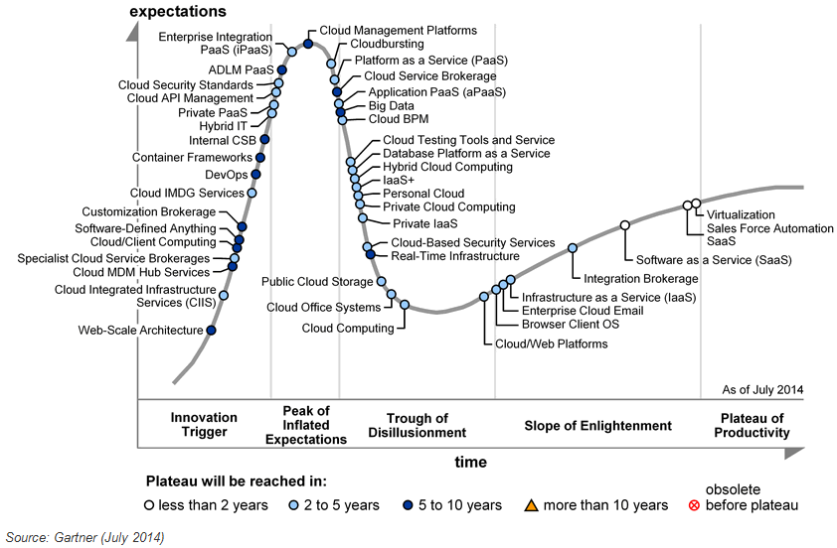
Technology Trends: Cloud Computing
Hype Cycle
Notes:
Source: Gartner

Slide 45
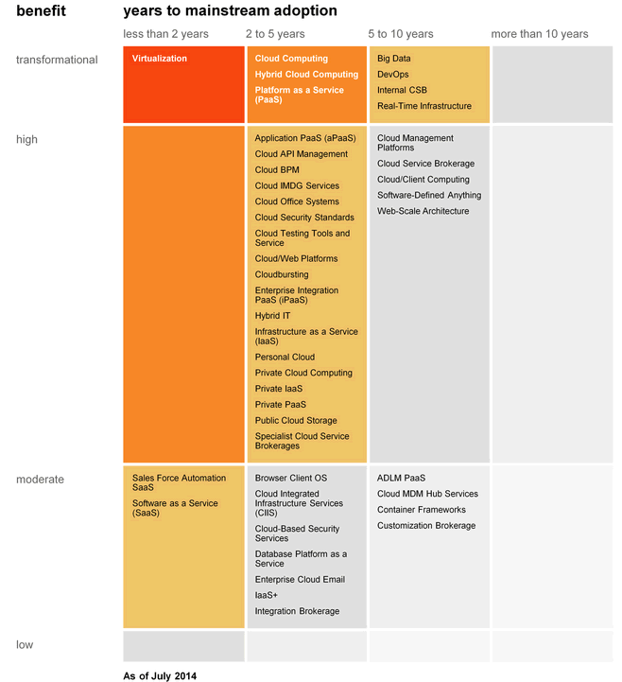
Technology Trends: Cloud Computing
Priority Matrix

Slide 46
Technology Trends: Cloud Computing Trends - Implications
Trends | Implications
Hybrid Cloud Computing | Hybrid cloud computing leads the way toward a unified cloud computing model, in which there is a single cloud that is made up of multiple sets of cloud facilities and resources (internal or external) that can be used, as needed, based on changing business requirements.
Cloud BPM | Collaborative process modeling, along with its social BPM features, allows a broad set of process participants — from the enterprise, service partners, suppliers and even end customers — to participate in the process of process improvement. The broad reach of collaborative process modeling supports the crowdsourcing of process improvement.
Cloud Integrated Infrastructure Services | A flexible and efficient combination of IaaS and PaaS will offer enterprises a more natural ramp up to cloud computing and, consequently, will increase the rate and scope of adoption of cloud by mainstream IT. Adoption of CIIS will likely establish new strategic relationships between the IT megavendors and enterprises. These new cloud-centric relationships will challenge the incumbents and may shake-up the IT industry leadership. New cloud-born vendors may enter and old enterprise giants may exit.
Cloud API Management | Cloud API management is useful for organizations publishing APIs to expand their reach to social, media, mobile and other emerging marketing communication channels. These organizations often need help planning, deploying and managing their API initiatives. It is also useful to the (frequently mobile application) developers embedding the APIs in their apps.
Enterprise Integration PaaS | By using iPaaS offerings, central IT departments and LOBs can quickly and cost-effectively integrate business processes that encompass cloud services and on-premises applications without acquiring, deploying and managing complex and expensive integration platforms. Through iPaaS, the state-of-the-art application and data integration technology that was used only by large organizations is now also accessible to midsize businesses, enabling them to improve the quality and agility of their business processes.
Cloud Management Platforms | Enterprises will require CMPs to maximize the value of cloud computing services, regardless of whether they're external (public), internal (private) or hybrid. This means increasing agility, managing and governing the consumption of cloud services, lowering the cost of service delivery, reducing the risks associated with these providers and potentially reducing lock-in to underlying software infrastructure.
Cloud bursting | Cloudbursting is the use of an alternative set of public or private cloud-based services as a way to augment and handle peaks in IT system requirements at startup or during runtime. Cloudbursting reduces the cost of provisioning IT systems for peak workloads (such as the holiday season or the quarterly close process) or overall peak capacity. It enables alternative providers' systems to be used as overflow for on-premises or cloud-based systems.
PaaS | PaaS offering is middleware capabilities offered as cloud services. There is a variety of types of middleware on-premises and Gartner tracks multiple types of PaaS, including application platform, integration, business process management, business analytics and database PaaS. With PaaS, enterprise IT has an opportunity to refocus from the responsibility for software infrastructure to some differentiated business services and to become more responsive to business demands; however, the cost of IT will not decline. Instead, it will be rearranged, with more spending going to cloud service providers and brokerages, and more internal IT spending on the composition of user-facing business solutions, management and integration
Notes:
Source: Gartner

Slide 47
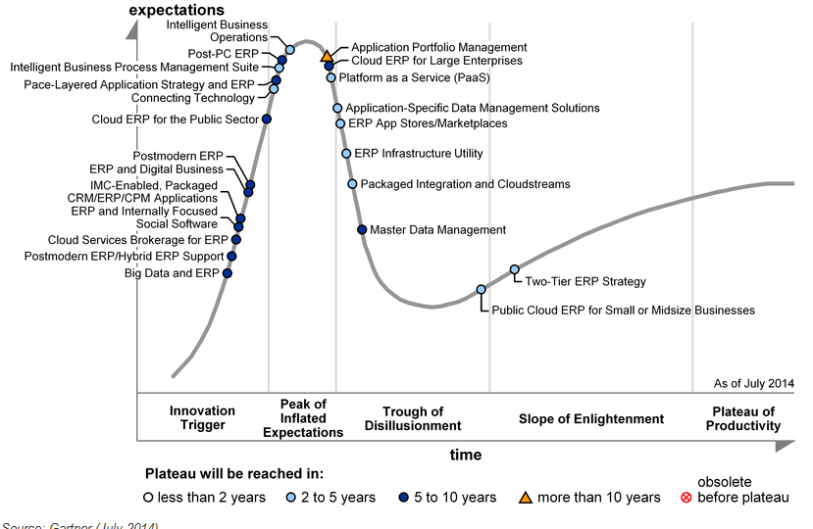
Technology Trends: ERP
Hype Cycle

Slide 48
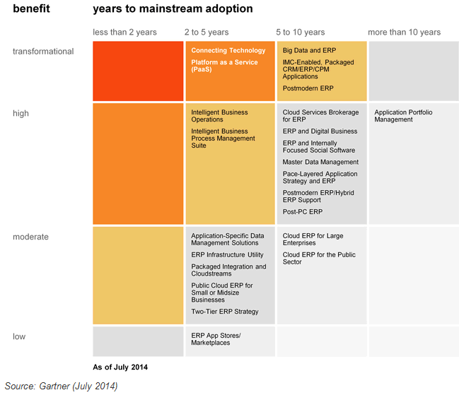
Technology Trends: ERP
Priority Matrix

Slide 49
Technology Trends: ERP Trends - Implications
Trends | Implications
Connecting Technology | A hybrid approach to ERP will include multiple applications from multiple vendors. These applications must be integrated using technology that is flexible, can manage the complexity of multiple applications with different architectures, have a business-process-oriented focus and do not overburden resources within the enterprise. Connecting technology does not refer to one product or technology. As organizations consider upgrades or replacement of their ERP suites, connecting technology enables replacement of components of the ERP suite without having to adopt an "all or nothing" replacement strategy. This enables organizations to be more flexible while maintaining data integrity, security and integration.
Intelligent Business Process Management Suite | An intelligent business process management suite (iBPMS) is an integrated set of technologies that adds built-in analytics, complex-event processing and knowledge worker collaboration to the technology formerly known as business process management suites (BPMSs). The iBPMS's application of embedded intelligence in agile processes gives business professionals a strong weapon in their arsenal that already includes applications and services. The difference here is that the iBPMS can be used to create differentiation around brittle best practices while reaching new opportunities with an intelligent, flexible and visually adjustable set of processes that can be outcome-driven or minimally linked to key performance indicators
Big Data & ERP | The emergence of big data will impact traditional ERP architectures that, to date, have largely been focused on a predictable stream of structured data. Big data has the potential to transform some — not all — data-intensive ERP business processes, especially those requiring heavy planning, simulation and analytical calculations. Big data for ERP is the ability to streamline the way that high-transaction volume industries run ERP processes. Enterprises in retail, utilities, distribution and insurance, for example, would be able to process large ERP transaction volumes more efficiently and derive more effective business analytics
Hybrid ERP Support | Hybrid ERP challenges the status quo of the IT organization. Cloud services add an extra layer of complexity to application support efforts, because much of the cloud service's life cycle is out of IT and the ERP leader's control. Supporting hybrid ERP requires service management capability — skills such as procurement, contract management and service management — which will require IT to expand its current focus, which, today, is mostly on technical delivery skills
ERP and Digital Business | The impact of digital business on ERP will follow quickly as organizations adopt new processes to respond to digital business. Digital business will break traditional barriers between industry segments, creating completely new value chains and creating new business opportunities that may not be filled by incumbent players. Businesses will introduce new products and services, even new business models, which are built around people, business and things that are connected together by the Internet. These things will create a level of value that will ensure their ability to compete for years into the future.

Slide 50
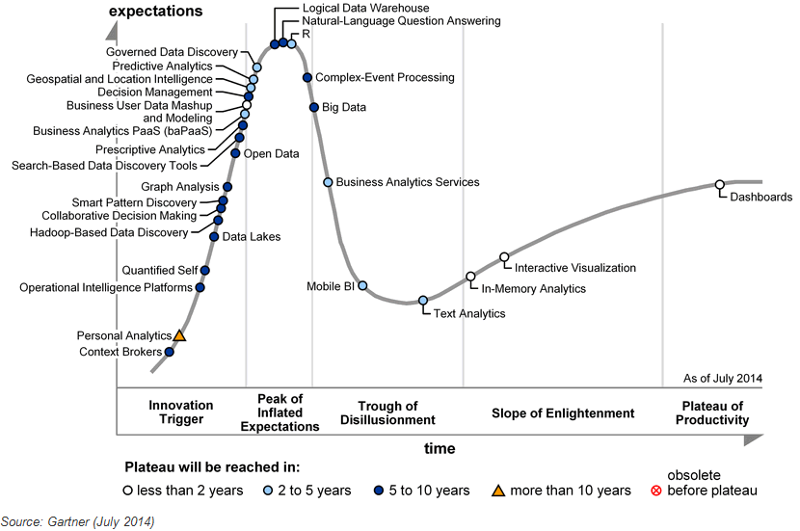
Technology Trends: Business Intelligence
Hype Cycle

Slide 51
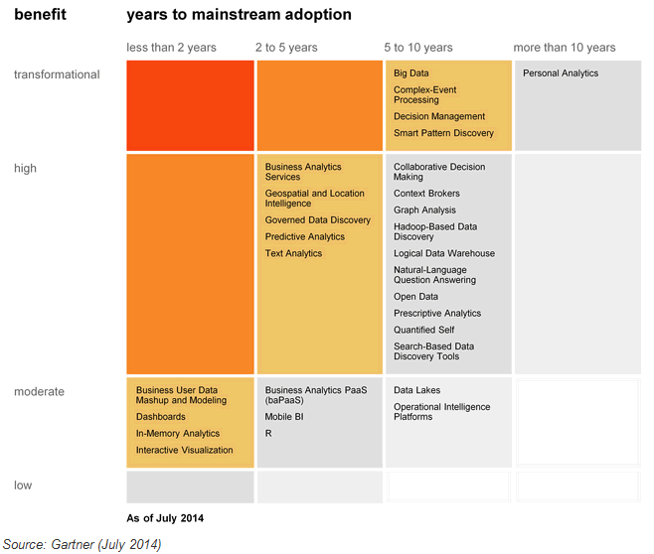
Technology Trends: Business Intelligence
Priority Matrix

Slide 52
Technology Trends: Business Intelligence Trends - Implications
Trends | Implications
Predictive Analytics | Predictive analytics is about extracting an analytical model from data, that anticipates future behavior or estimates unknown outcomes. It is most often being performed via a variant of machine learning called "supervised learning." This new sense of excitement surrounding predictive analytics is driven by a surge of interest in non classical use cases, such as demand prediction, determining deficiencies around service and product quality, new types of fraud detection and predictive maintenance.
Business Analytics Services | Business analytics services are consulting and implementation services that combine capabilities in decision, analytics and information, executed on a technology platform supporting an organization's fact-based decision making. Solutions are composed from information analysis and information management competencies with commercial off-the-shelf (COTS) and proprietary assets developed by service providers. Information analysis solutions focus on use cases and outcomes, and information management solutions focus on information infrastructure. Enterprises that are transforming from being process-driven to information-driven to leverage information as an asset will see the highest impact from business analytics services.
Text Analytics | Text analytics can be used in a wide variety of use cases and in multiple parts of a company. Sentiment analysis can provide insight into customer satisfaction across multiple channels and generate contextual understanding of content that has value as input for predictive analytics models. Monitoring for particular terms or phrases can help to pinpoint areas of concern. Using text analytics to classify a body of text during ingestion or upload may improve "findability" in the future, or allow for greater control in information governance. Big data analytics — especially combining structured and unstructured data sources — can provide more insights into new opportunities and also missed opportunities. In the area of speech analytics, text analytics can significantly improve organization agility via capture and analyses with low latency on the full content of the voice conversation — which was impossible before — for agent upskilling, competitive intelligence and market intelligence. There are numerous potential use cases for which text analytics, combined with any of the many other analytic capabilities, will have a significant impact on an organization only if it is aware of the questions it needs answering and is willing to act on the results received. This is something each organization should explore carefully before embarking on a text analytics initiative.
Governed data discovery | Governed data discovery enables business users to prepare and combine data for analytics, then explore and interact with it visually, with governance to enable data discovery to be deployed and managed across an enterprise. It is a set of capabilities that enables users to access, blend and prepare data, then visually explore, find and share patterns with minimal IT support, technical or statistical skills. This will enable organizations to expand the benefits of data discovery capabilities in the enterprise. This includes putting a broader range of analysis in the hands of users who do not have technical or data science capabilities, without sacrificing enterprise requirements for governance, reusability and embeddability

Slide 53
Global Software Services MI
Market Drivers

Slide 54
Global Software MI: Market Drivers Industry Growth Drivers & Challenges
Growth Drivers
Growth Challenges
Cloud driving the differentiation in delivery model.
New commercial models offering alternative ways to procure software, like SaaS, Pay-as- you-go, freemium, etc.
Mobile apps and application development are driving the differentiation in platform.
Huge software market for mobility devices is being created.
Rising demand in information management software and enterprise vertical and enterprise process applications.
Growing demand for SaaS solutions in in enterprise process applications, security, employee-facing desktop applications, and certain information management applications.
Continuing demand in the software market from the developed world (especially the Tech Twelve Group - US, Australia, Canada, Denmark, Finland, Israel, Netherlands, New Zealand, Singapore, Sweden, Switzerland, & UK.
Big vendors continue buying (acquisition) spree to strengthen information management/integration portfolios.
Data volumes continue to grow and require increasing levels of protection.
Security concerns over data on Cloud.
Several companies are showing resistance to SaaS because of various reasons: security concerns, Integration challenges with other applications, lack of customization, total cost of ownership, etc.
Software piracy and rampant copying issues.
With European countries are in deep recession, CIOs will cut their purchases of tech goods and services by. That will be surly a back force working against Software market growth.

Slide 55

Send your feedback / suggestions to the analyst team:
sutirtha.sen@tcs.com
d.basak@tcs.com

